Slide 1
DBMS(Database Management Systems)
UNIT-1

Slide 2
What is Data?
Data is a raw and unorganized fact that required to be processed to reveal their meaning.
Example of Data:
Andhra, RAM, ANITS, Reddi ,500050,4675652839, Tagarapuvalasa, Vizag
What is Information?
Information is a set of data which is processing raw data to reveal its meaning .
Example of Information:
Reddi RAM
ANITS,
4675652839
Tagarapuvalasa, Vizag(500050)
Andhra

Slide 3
What is Database(DB):
A database is a collection of data .typically describing the activities of one or more related organization.
Management System:
set of programs to store and retrieve those data .
What is DBMS?
DBMS is a collection of data and set of programs to access & store those data in an easy and efficient manner .
Database Management System (also known as DBMS) is a software for define, manipulate, retrieve and manage data in a database'
MySQL Database, MS- Access, Oracle Database, Microsoft SQL Server, etc.

Slide 4
Purpose of Database System
In the early days, database applications were built directly on top of file systems
Drawbacks of using file systems to store data:
– Data redundancy and inconsistency
– Difficulty in accessing data
– Data isolation — multiple files and formats
– Integrity problems
– Atomicity of updates
Example: Transfer of funds from one account to another should either complete or
not happen at all
– Concurrent access by multiple users
Example: Two people reading a balance and updating it at the same time.

Slide 5
Database Applications:
– Banking: all transactions
– Airlines: reservations, schedules
– Universities: registration, grades
– Sales: customers, products, purchases
– Online retailers: order tracking, customized recommendations
– Manufacturing: production, inventory, orders, supply chain
– Human resources: employee records, salaries, tax deductions

Slide 6
1.2 Advantage of DBMS over file system
Data independence:
Efficient Data Access
Data Integrity
Data Administration
Concurrent Access and Cash Recovery
Reduced Application Development

Slide 7
1.3 Storage Data
1.3.1 The Relational Model
The central data description construct in this model is relation, which can be thought of as a set of records.
A description of data in terms of a data model is called a schema.
The schema for a relation specifies its name, the name of each field or attribute or column.

Slide 8
Example: student information in a university database my be stored in a relation with the following schema (with 5 fields):Students(sid: string, name: string, login: string, age: integer, gpa: real)
An example instance of the Students relation:
sid | name | login | age | gpa
53666 | Jones | jones@cs | 18 | 3.4
53588 | Smith | smith@ee | 18 | 3.2
Each row in the Students relation is a record that describes a student. Every row follows the schema of the Student relation and schema can therefore be regarded as a template for describing a student.

Slide 9
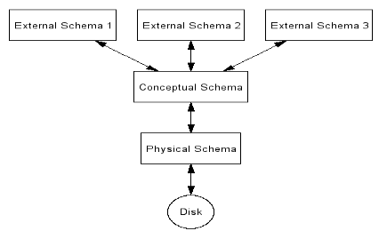
1.3.2 Levels of Abstraction in DBMS

Slide 10
LEVELS OF DATA ABSTRACTIONS
Physical level: describes how a record (e.g., customer) is stored.
• Logical level: describes data stored in database, and the relationships among the data.
type customer = record
customer_id : string;
customer_name : string;
customer_street : string;
customer_city : string;
end;
View level: application programs hide details of datatypes. Views can also hide information (such as an employee’s salary) for security purposes.

Slide 11
Instance and Schema
• Instance – the actual content of the database at a particular point in time
– Analogous to the value of a variable
Similar to types and variables in programming languages
• Schema – the logical structure of the database
– Example: The database consists of information about a set of customers and accounts and the relationship between them)
– Physical schema: database design at the physical level
– Logical schema: database design at the logical level

Slide 12
1.3.3 Data Independence
Data independence is achieved through the use of the three levels of data abstraction; in particular, the conceptual schema and the external schema provide distinct benefits in this area.
Logical data Independence:
  Users can be shielded from changes in the logical structure of the data, or changes in the choice of relations to be stored.
  Example: Student_public, Student_private => create levels using views in external schema
Physical data independence:
  The conceptual schema insulates users from changes in the physical storage of the data.
  The conceptual schema hides details such as how the data is actually laid out on disk, the file structure, and the choice of indexes.

Slide 13
1.4 Queries In a DBMS
A query is a question, often expressed in a formal way. A database query can be either a select query or an action query. A select query is a data retrieval query, while an action query asks for additional operations on the data, such as insertion, updating or deletion.

Slide 14
1.5 Transaction Management in DBMS
A transaction is a set of logically related operations. For example, you are transferring money from your bank account to your friend’s account, the set of operations would be like this:
Simple Transaction Example
Read your account balance
2. Deduct the amount from your balance
3. Write the remaining balance to your account
4. Read your friend’s account balance
5. Add the amount to his account balance
6. Write the new updated balance to his account
This whole set of operations can be called a transaction.

Slide 15
Continued………………..
In DBMS, we write the above 6 steps transaction like this:
Lets say your account is A and your friend’s account is B, you are transferring 10000 from A to B, the steps of the transaction are:
R(A);
2. A = A - 10000;
3. W(A);
4. R(B);
5. B = B + 10000;
6. W(B);
In the above transaction R refers to the Read operation and W refers to the write operation.

Slide 16
Continued………………….
Transaction failure in between the operations
The main problem that can happen during a transaction is that the transaction can fail before finishing the all the operations in the set. This can happen due to power failure, system crash etc. This is a serious problem that can leave database in an inconsistent state. Assume that transaction fail after third operation (see the example above) then the amount would be deducted from your account but your friend will not receive it.

Slide 17
Continued…………………..
To solve this problem, we have the following two operations
Commit: If all the operations in a transaction are completed successfully then commit those changes to the database permanently.
Rollback: If any of the operation fails then rollback all the changes done by previous operations.

Slide 18
ACID properties in DBMS
A transaction is a unit of program that updates various data items, the database system maintains the following properties. These properties are widely known as ACID properties:
Atomicity: This property ensures that either all the operations of a transaction reflect in database or none.
1.
A
$500
B
$600

Slide 19
2.
3.
4.
A
B
A→B
A-100
B+100
A
$400
B
$600

Slide 20
Let’s take an example of banking system to understand this: Suppose Account A has a balance of 400$ & B has 700$. Account A is transferring 100$ to Account B. This is a transaction that has two operations a) Debiting 100$ from A’s balance b) Creating 100$ to B’s balance. Let’s say first operation passed successfully while second failed, in this case A’s balance would be 300$ while B would be having 700$ instead of 800$. This is unacceptable in a banking system. Either the transaction should fail without executing any of the operation or it should process both the operations. The Atomicity property ensures that.

Slide 21
Consistency − The database must remain in a consistent state after any transaction.
No transaction should have any adverse effect on the data residing in the database.
If the database was in a consistent state before the execution of a transaction, it must remain consistent after the execution of the transaction as well.
Example:
account A is having a balance of 400$ and it is transferring 100$ to account B & C both.
So we have two transactions here. Let’s say these transactions run concurrently and both the transactions read 400$ balance, in that case the final balance of A would be 300$ instead of 200$, This is wrong. This type of consistency is ensured.

Slide 22
Isolation − In a database system where more than one transaction are being executed simultaneously and in parallel, the property of isolation states that all the transactions will be carried out and executed as if it is the only transaction in the system. No transaction will affect the existence of any other transaction.
Durability: Once a transaction completes successfully, the changes it has made into the database should be permanent even if there is a system failure. The recovery-management component of database systems ensures the durability of transaction.

Slide 23
1.6 DBMS Structure
A database system is partitioned into modules that deal with each of the responsibilities of the overall system.
The functional components of a database system can be broadly divided into the storage manager and the query processor components.
The storage manager is important because databases typically require a large amount of storage space.
The query processor is important because it helps the database system simplify and facilitate access to data.

Slide 24
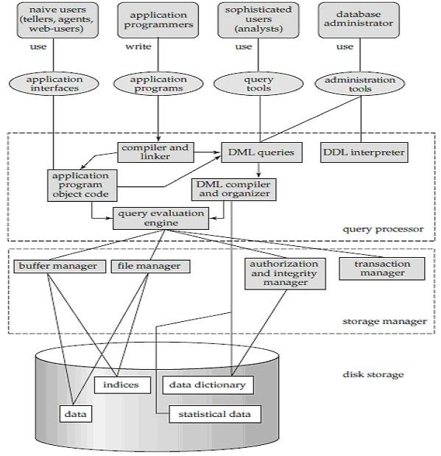

Slide 25
Query Processor
The query processor components include
· DDL interpreter, which interprets DDL statements and records the definitions in the data dictionary.
· DML compiler, which translates DML statements in a query language into an evaluation plan consisting of low-level instructions that the query evaluation engine understands.
A query can usually be translated into any of a number of alternative evaluation plans that all give the same result. The DML compiler also performs query optimization, that is, it picks the lowest cost evaluation plan from among the alternatives.
· Query evaluation engine, which executes low-level instructions generated by the DML compiler.

Slide 26
Storage Manager
A storage manager is a program module that provides the interface between the low level data stored in the database and the application programs and queries submitted to the system.
The storage manager is responsible for the interaction with the file manager.
The raw data are stored on the disk using the file system, which is usually provided by a conventional operating system.
The storage manager translates the various DML statements into low-level file-system commands.
Thus, the storage manager is responsible for storing, retrieving, and updating data in the database.

Slide 27
Continued………
The storage manager components include:
Authorization and integrity manager, which tests for the satisfaction of integrity constraints and checks the authority of users to access data.
Transaction manager, which ensures that the database remains in a consistent (correct) state despite system failures, and that concurrent transaction executions proceed without conflicting.
File manager, which manages the allocation of space on disk storage and the data structures used to represent information stored on disk.
Buffer manager, which is responsible for fetching data from disk storage into main memory, and deciding what data to cache in main memory. The buffer manager is a critical part of the database system, since it enables the database to handle data sizes that are much larger than the size of main memory.

Slide 28
Transaction Manager
A transaction is a collection of operations that performs a single logical function in a database application.
Each transaction is a unit of both atomicity and consistency.
Transaction - manager ensures that the database remains in a consistent (correct) state despite system failures (e.g., power failures and operating system crashes) and transaction failures.

Slide 29
2.1 Data Models
(Chapter-2)
What is Data Modelling?
This data model is a conceptual representation of Data objects.
Data Model is a logical structure of Database. It describes the design of database to reflect entities, attributes, relationship among data, constrains etc.
Data Model is like architect's building plan which helps to build a conceptual model and set the relationship between data items.

Slide 30
Continued……..
Types of Data Models
There are three types of data model
Conceptual: The main aim of conceptual model is to establish the entities, their attributes, and their relationships.
2. logical: Logical data model defines the structure of the data elements and set the relationships between them
3. Physical : A Physical Data Model describes the database specific implementation of the data model.

Slide 31
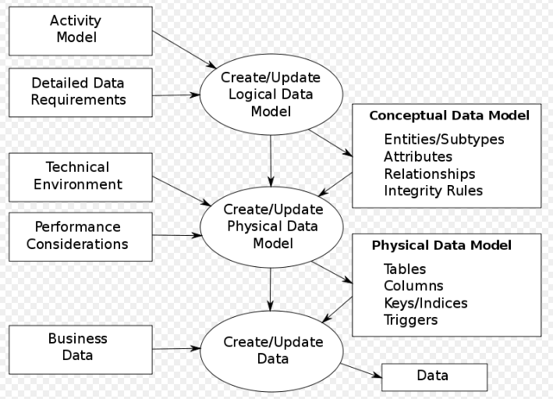

Slide 32
Data Model Implementation
Object based logical Models – Describe data at the conceptual and view levels. These are
i) Entity Relationship (E-R) Model
ii) UML (Unified Modelling Language)

Slide 33
Record based logical Models – Like Object based model, they also describe data at the conceptual and view levels. These models specify logical structure of database with records, fields and attributes. These are
Relational Model
Hierarchical Model
iii) Network Model – Network Model is same as hierarchical model except that it has graph-like structure rather than a tree-based structure. Unlike hierarchical model, this model allows each record to have more than one parent record.

Slide 34
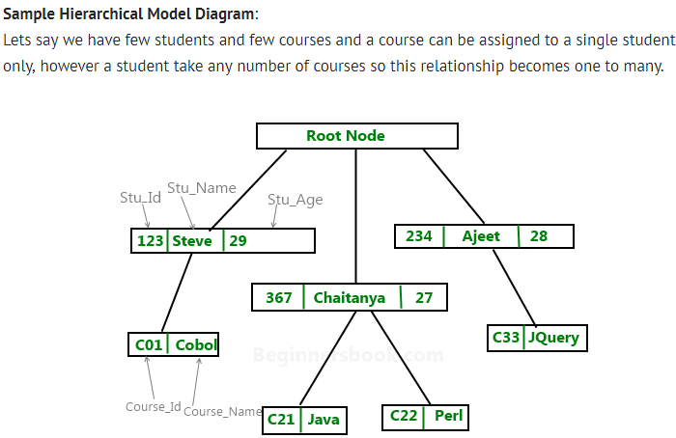
Hierarchical model in DBMS
In hierarchical model, data is organized into a tree like structure with each record is having one parent record and many children.

Slide 35
2.2 Importance of Data model:
The main goal of a designing data model is to make certain that data objects offered by the functional team are represented accurately.
The data model should be detailed enough to be used for building the physical database.
The information in the data model can be used for defining the relationship between tables, primary and foreign keys, and stored procedures.
Data Model helps business to communicate the within and across organizations.
Data model helps to documents data mappings in ETL process
Help to recognize correct sources of data to populate the model

Slide 36
2.3 Basic Building Blocks-Data Model
Entity
i) Is anything (a person, a place, a thing, or an event)
ii) Represents a particular type of object in the real world.

Slide 37
Attribute
Is a characteristic of an entity.
Example:
A CUSTOMER entity would be described by attributes such as customer last name, first name, phone, address, and credit limit.

Slide 38
RelationShip
Describes an association among entities.
Example.
  A relationship exist between customers and agents that can be described as follows:
  An agent can serve many customers, and each customer may be served by one agent.

Slide 39
Three types of Relationship
One-to-One
Many-to-many
Many-to-one
One-to-Many

Slide 40
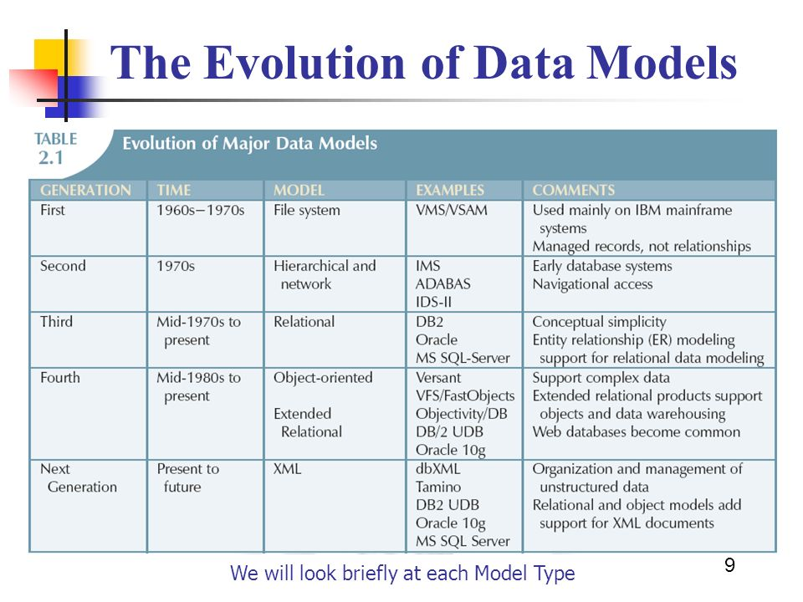
2.4 Evolution of Data Models

Slide 41
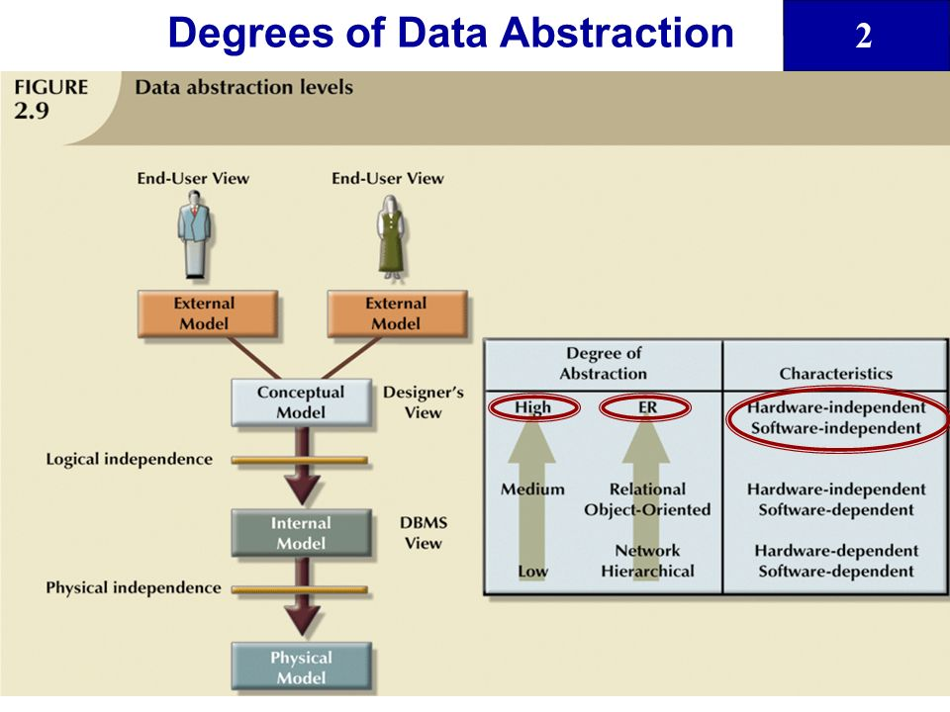
2.5 Degree of Data Abstraction

Slide 42
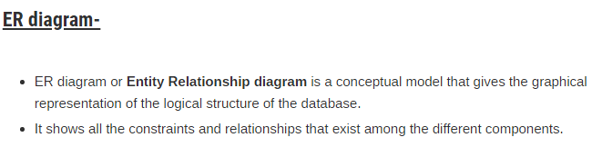
Chapter-3
E-R Model

Slide 43
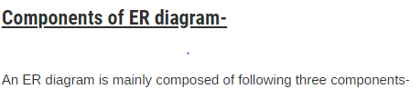
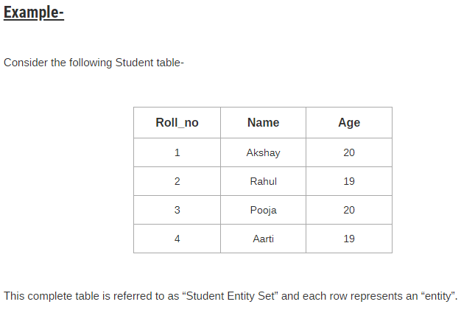
Entity Sets
Attributes
Relationship Set

Slide 44
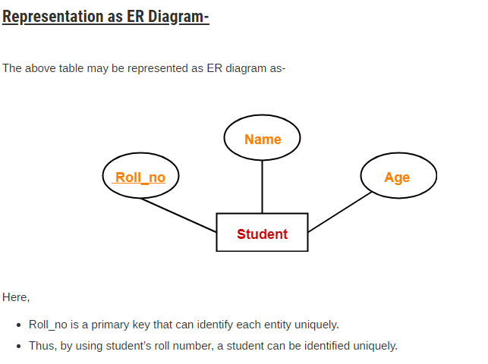

Slide 45
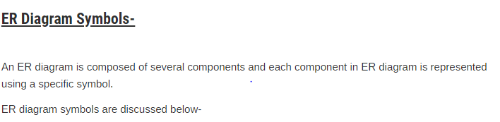
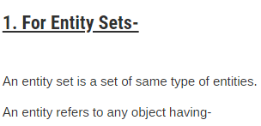

Slide 46
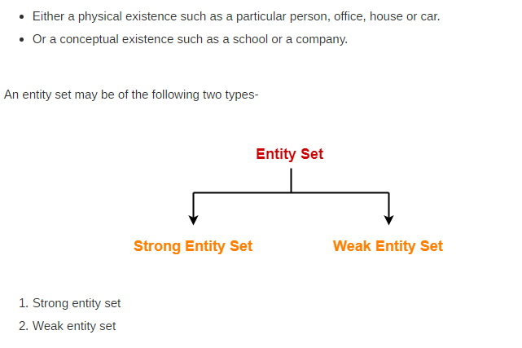
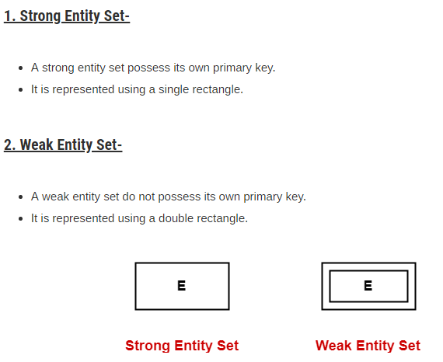

Slide 47
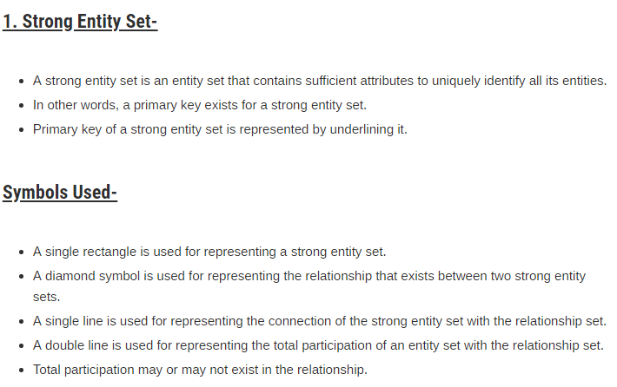

Slide 48
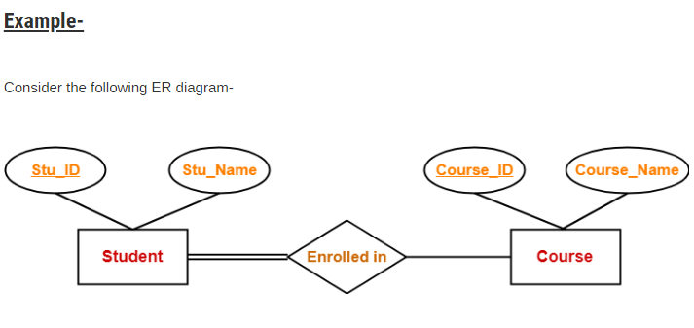
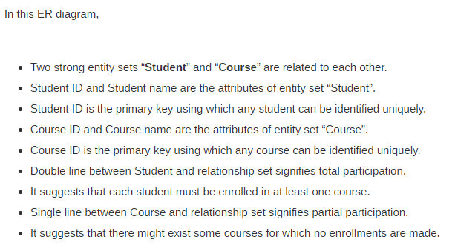

Slide 49
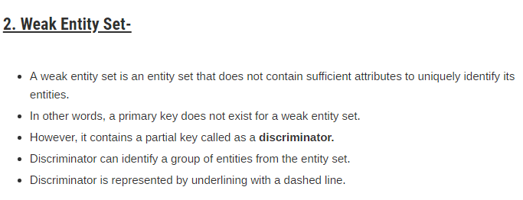
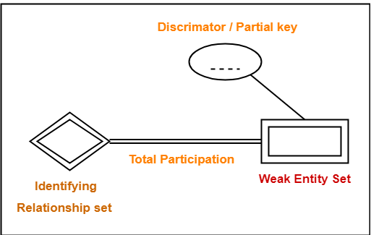
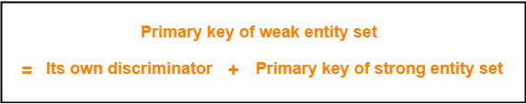

Slide 50
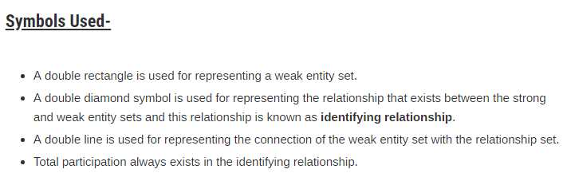
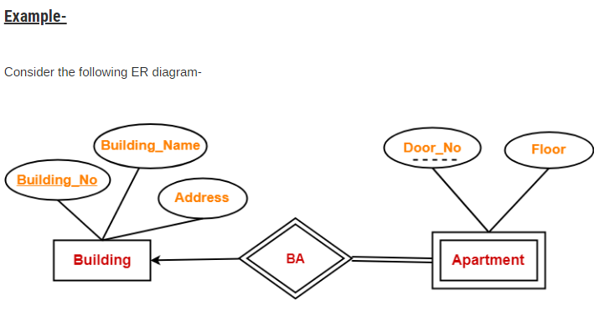

Slide 51
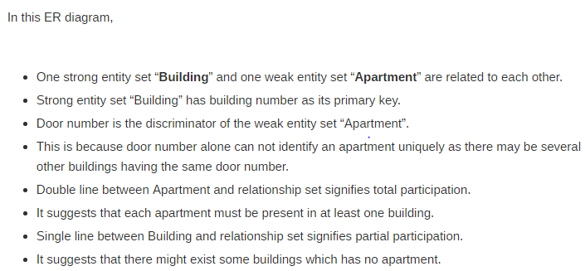
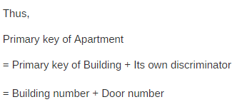

Slide 52
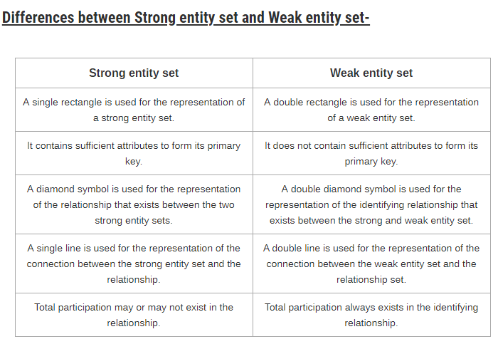

Slide 53


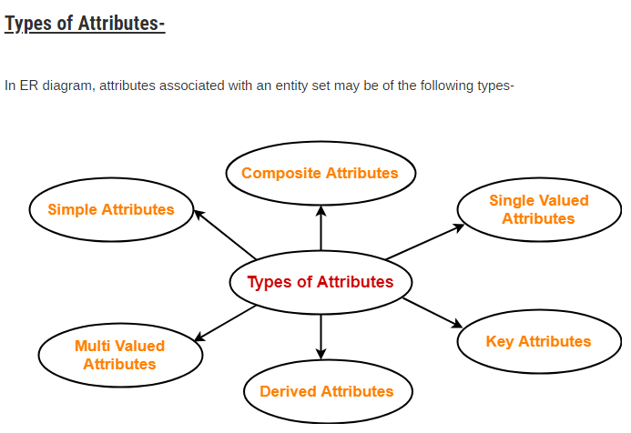

Slide 54
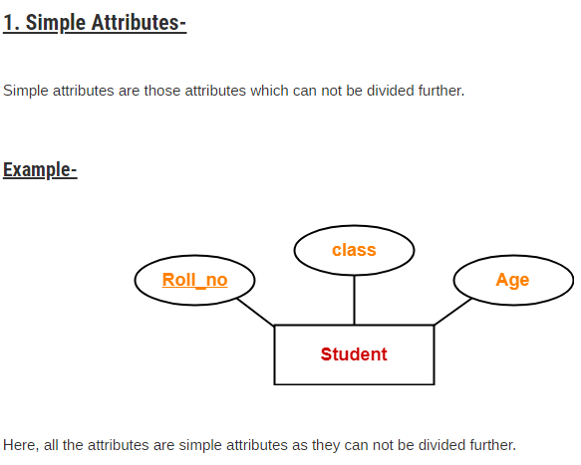

Slide 55
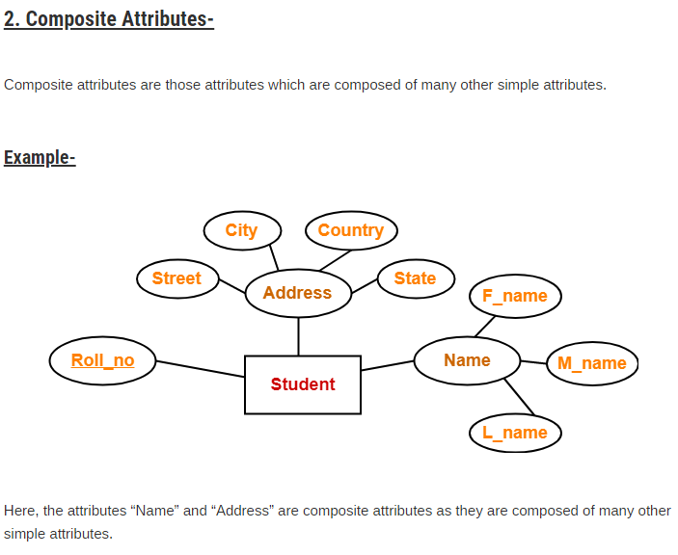

Slide 56
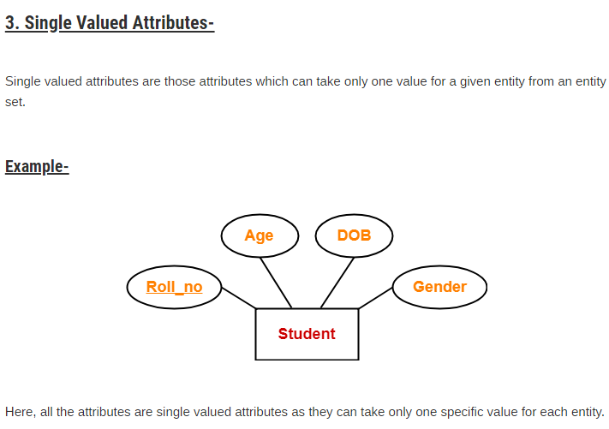

Slide 57
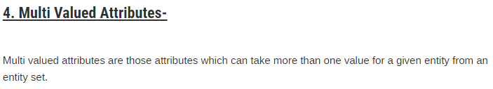
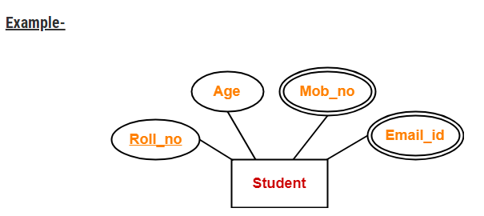

Slide 58
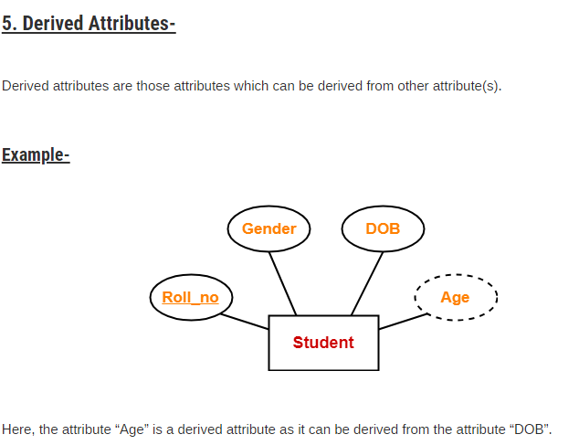

Slide 59
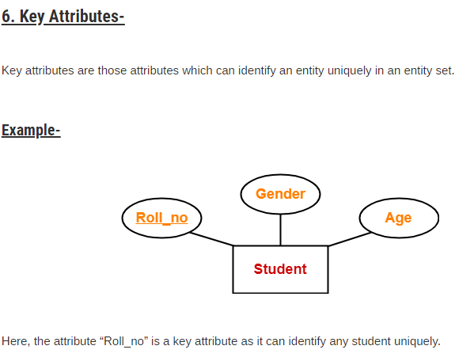

Slide 60


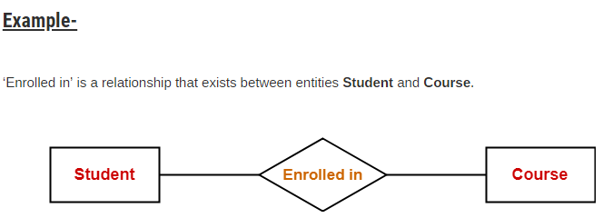

Slide 61
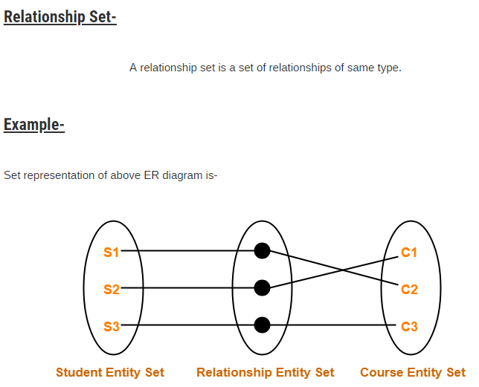

Slide 62
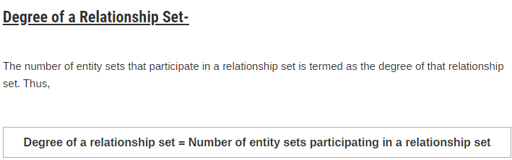
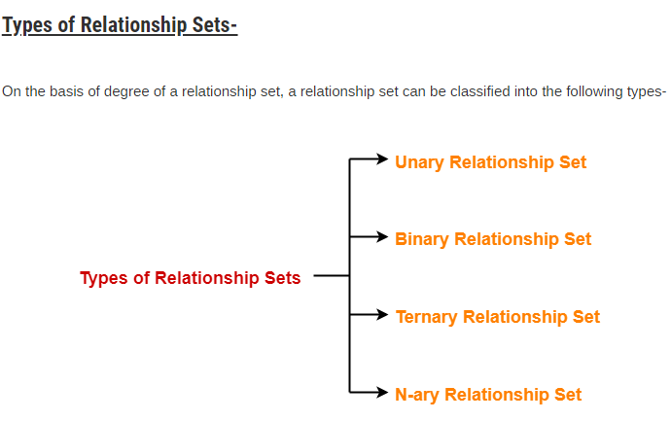

Slide 63
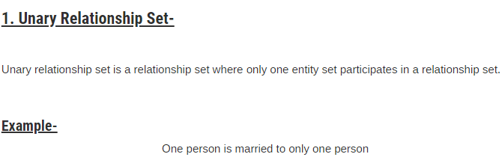
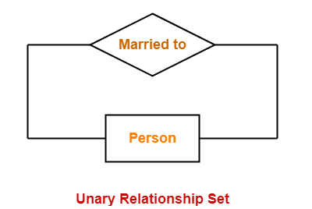

Slide 64
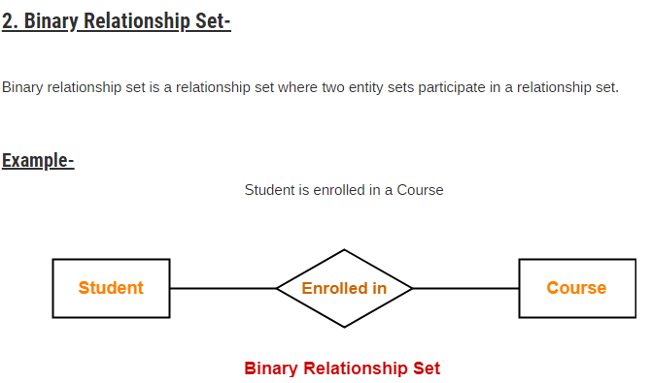

Slide 65
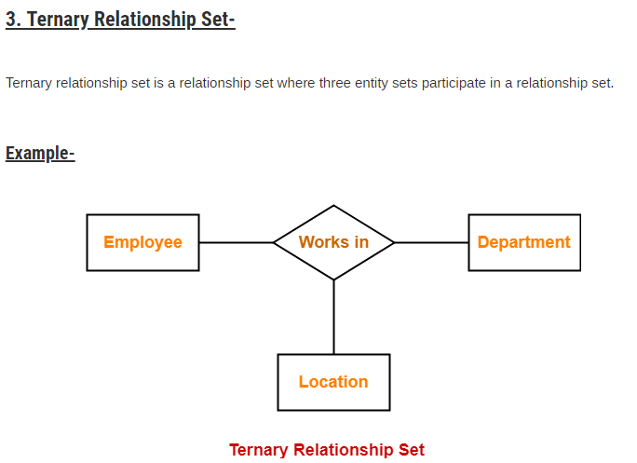
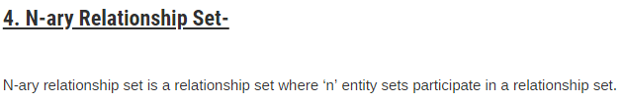

Slide 66
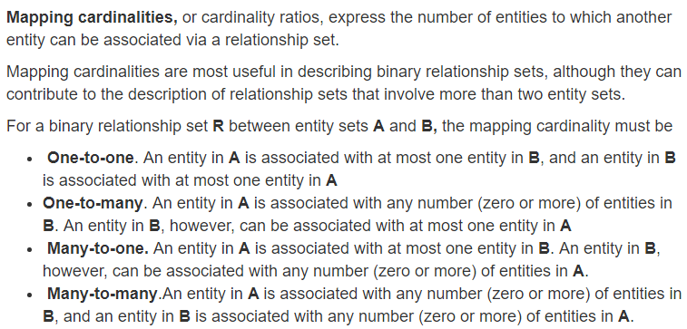

Slide 67
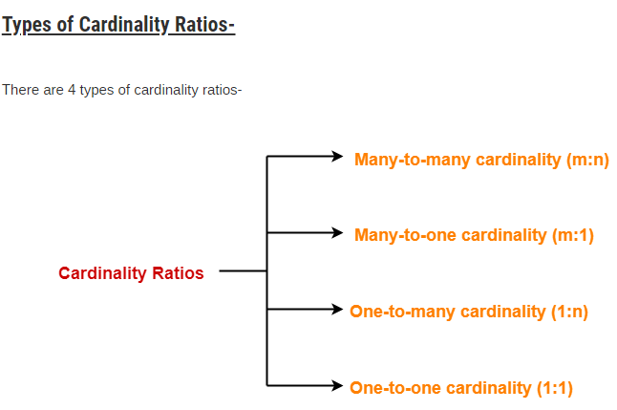

Slide 68
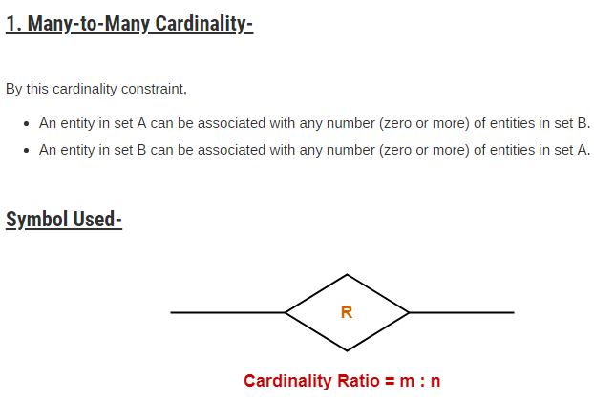
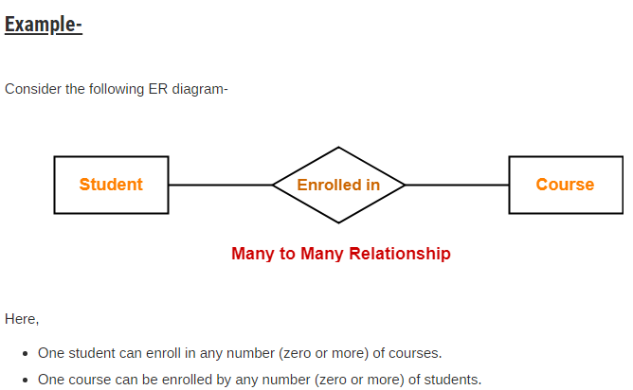
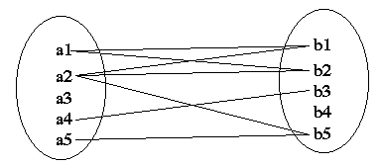

Slide 69





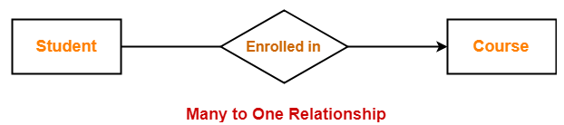

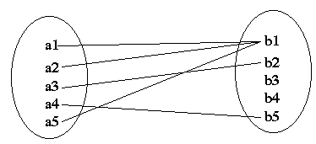

Slide 70


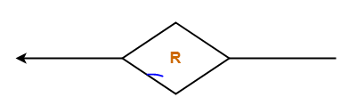





Slide 71




Consider the following ER diagram-
Here,
One student can enroll in at most one course.
One course can be enrolled by at most one student.

Slide 72

KEYS

Slide 73



Slide 74


Slide 75


Slide 76


Slide 77



Slide 78




Slide 79

ER diagram is converted into the tables in relational model.
This is because relational models can be easily implemented by RDBMS like MySQL , Oracle etc.
Following rules are used for converting an ER diagram into the tables-

Slide 80



Slide 81




Slide 82



Slide 83





Slide 84



Slide 85


Slide 86


Slide 87


Slide 88



Slide 89


Slide 90


Slide 91


Slide 92



Slide 93



Slide 94



Slide 95



Slide 96
Conceptual Design Using the ER Model
Design choices:
– Should a concept be modeled as an entity or an attribute?
– Should a concept be modeled as an entity or a relationship?
– Identifying relationships: Binary or ternary? Aggregation?
Constraints in the ER Model:
– A lot of data semantics can (and should) be captured.
– But some constraints cannot be captured in ER diagrams.

Slide 97
Entity vs. Attribute
Should address be an attribute of Employees or an entity (connected to Employees by a relationship)?
Depends upon the use we want to make of address information, and the semantics of the data:
If we have several addresses per employee,address must be an entity (since attributes
cannot be set-valued).
If the structure (city, street, etc.) is important,e.g., we want to retrieve employees in a given city, address must be modeled as an entity (since attribute values are atomic).

Slide 98

Entity vs. Attribute (Contd.)
Works_In4 does not allow an employee to work in a department for two or more periods.
Similar to the problem of wanting to record several addresses for an employee: We want to record several values of the descriptive attributes for each instance of this relationship. Accomplished by introducing new entity set, Duration.

Slide 99

Entity vs. Relationship
First ER diagram OK if a manager gets a separate discretionary budget for each dept.
What if a manager gets a discretionary budget that covers all managed depts?
Redundancy: dbudget stored for each dept managed by manager.
- Misleading: Suggests dbudget associated with department-
mgr combination.

Slide 100

Binary vs. Ternary Relationships
If each policy is owned by just 1 employee, and each dependent is tied to the covering policy, first diagram is inaccurate.
What are the additional constraints in the 2nd diagram?
Previous example illustrated a case when two binary relationships were better than one ternary
relationship.
An example in the other direction: a ternary relation
Contracts relates entity sets Parts, Departments and
Suppliers, and has descriptive attribute qty.
– S “can-supply” P, D “needs” P, and D “deals-
with” S does not imply that D has agreed to buy P from S.
– How do we record qty?

Slide 101

Aggregation v/s ternary relationship

Slide 102


Slide 103


Slide 104
End

